Slide 1
Stock Price Movement Prediction Using Machine Learning
Team Members:
Koushik Reddy Sudireddy – 11885863
Merla Ganesh Reddy – 11797294
Ruthvika Muchala - 11906895

Slide 2
Problem Statement
Generally, Stock markets are highly volatile and are influenced by multiple factors.
Predicting next-day price directions (UP/DOWN) can be useful in automated trading and risk management.
The goal is to classify the return of a stock the next day based on historical price and technical indicators.

Slide 3
Objectives
Preprocess and clean large-scale stock price datasets.
Create meaningful technical features: RSI, MACD, ATR, Bollinger bands, lags
To train ML models using Logistic Regression, Random Forest, and XGBoost for directional prediction.
To evaluate the models using Accuracy, Precision, Recall, F1, ROC-AUC.
To do walk-forward validation and backtesting to simulate real-world trading.

Slide 4
Challenges
Handling large dataset (851k+ rows, 500+ tickers)
Alignment of time series data, missing sectors, and date cleaning.
Handling Data Leakage Across Time:
Predictive accuracies remain near random levels because of market efficiency.
Unbalanced Behaviour in Returns.

Slide 5
Methodology
Data Loading (Prices.csv, Securities.csv)
Data Cleaning (sorting, merging, handling missing sectors)
Exploratory Data Analysis
Feature Engineering (Technical Indicators)
Train–Validation–Test Split using time-based windows
Model Training
Evaluation Metrics
Walk-forward validation
Backtesting with Random Forest strategy

Slide 6
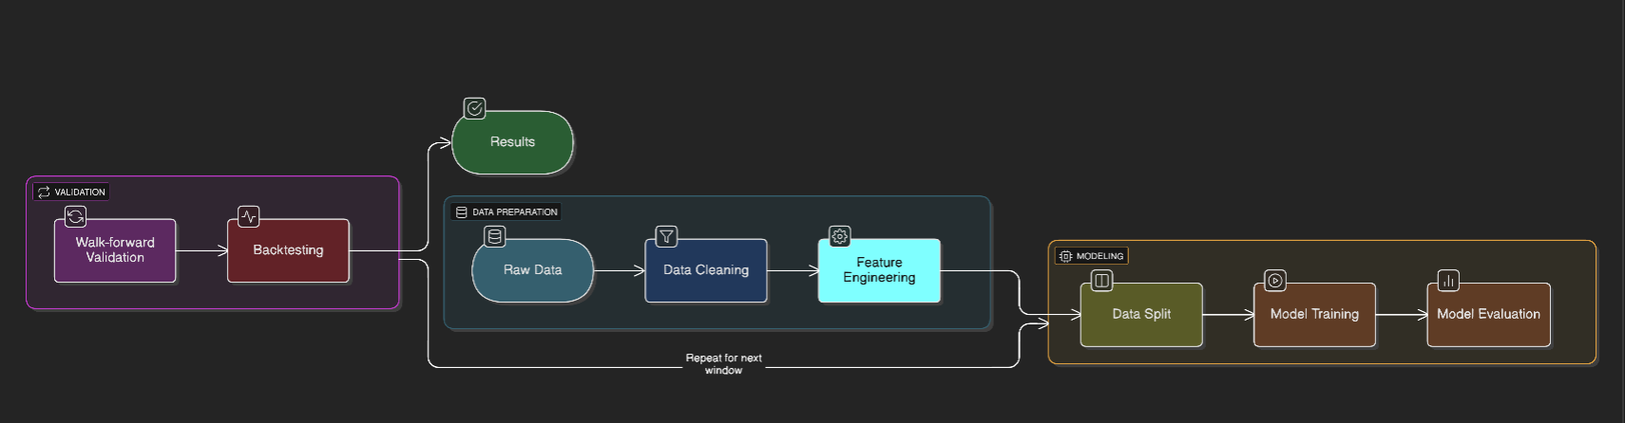
Flow of work

Slide 7






Tools and Techniques
At-a-glance
Programming
Libraries
Vizualisation
Ml models
environment
Python was used due to its simplicity and rich ecosystem for data analysis and machine learning.
NumPy, Pandas, Scikit-learn, XGBoost, and TA were used for numerical processing, machine learning, and generating technical indicators essential for stock prediction.
Matplotlib, Seaborn, and Plotly helped visualize trends, correlations, and model results through static and interactive charts.
We used Logistic Regression, Random Forest, and XGBoost to model and predict next-day stock price movements.
The project was developed in Google Colab and Jupyter Notebook, enabling an interactive workflow with seamless coding, visualization, and experimentation.

Slide 8
Results
Baseline Models:
  Prev Day Return Accuracy: ~0.488
  MA Crossover Accuracy: ~0.492
Machine Learning Models (Best ~0.53 accuracy):
  Logistic Regression: 0.49
  Random Forest: 0.535 (best)
  XGBoost: 0.526
Walk-forward Validation Average:
  Accuracy: 0.49–0.50
  F1 Score highest for XGBoost (0.51)
Model | Accuracy | Precision | Recall | F1 | ROC-AUC
Logistic | 0.494 | 0.507 | 0.395 | 0.444 | 0.506
Random Forest | 0.535 | 0.562 | 0.407 | 0.472 | 0.547
XGBoost | 0.526 | 0.541 | 0.486 | 0.512 | 0.550

Slide 9
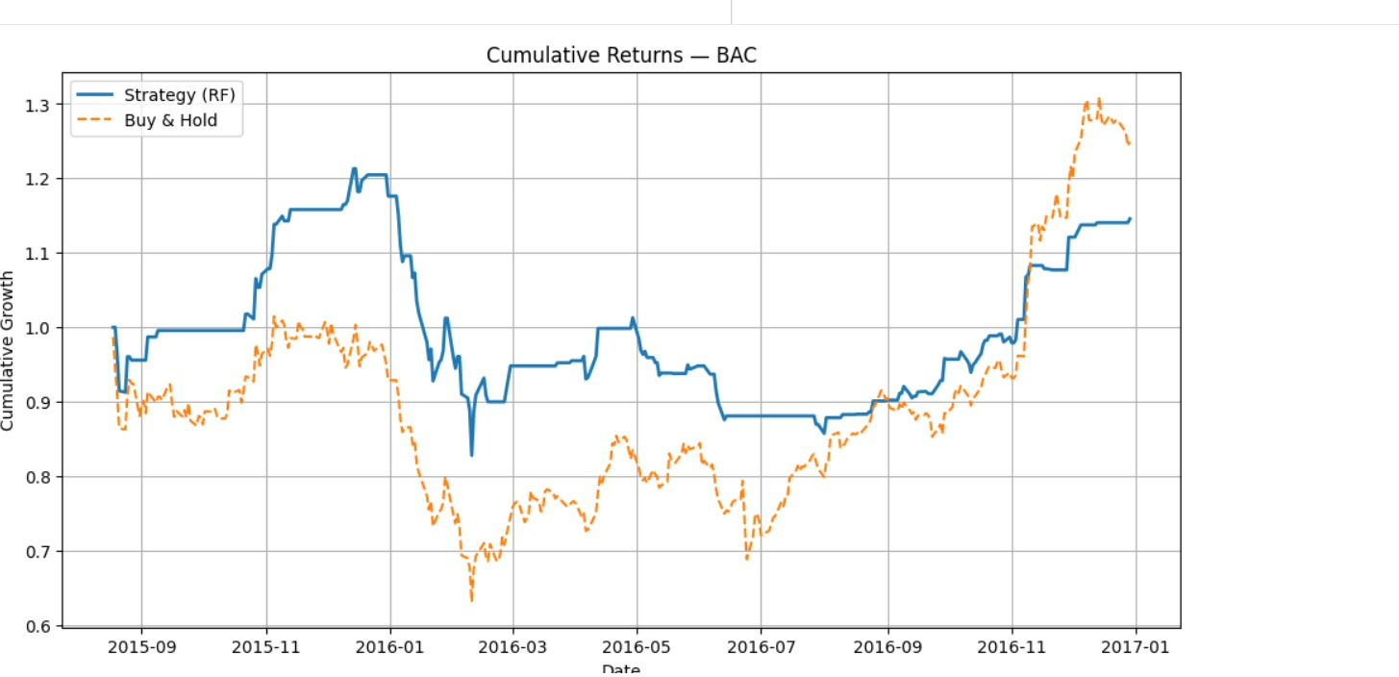
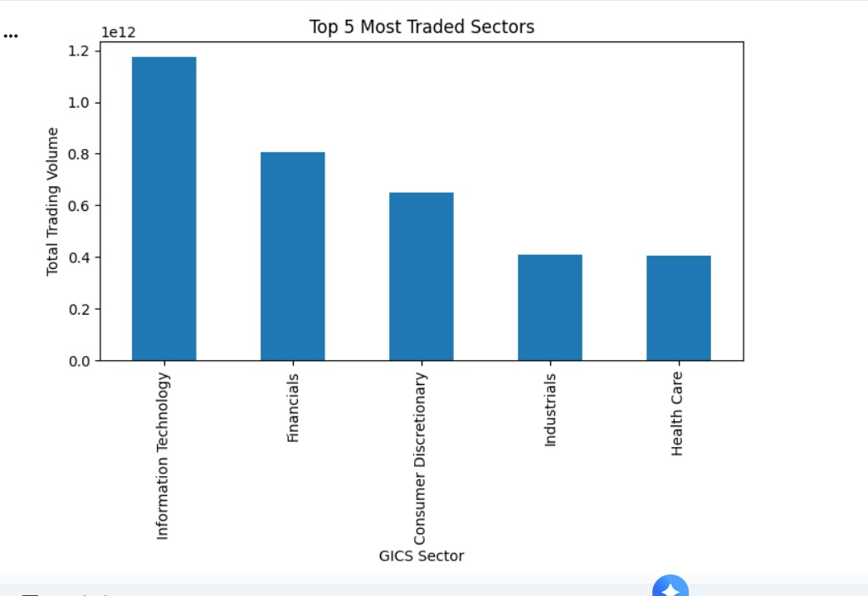
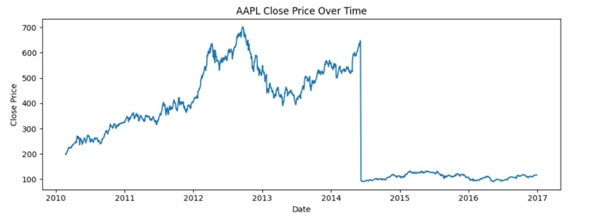

Slide 10
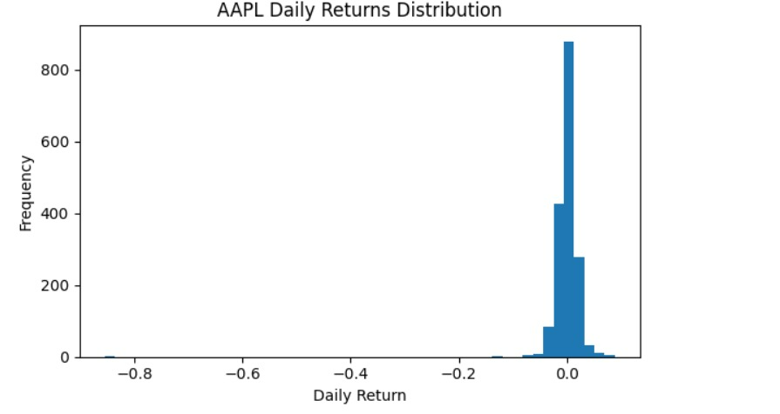
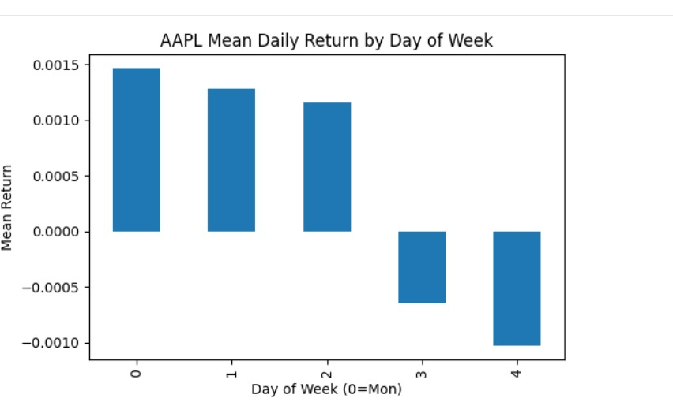
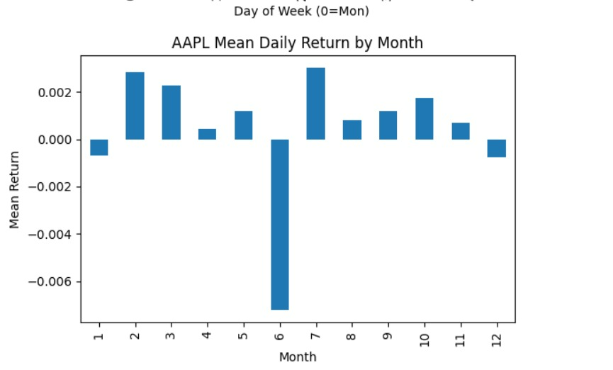

Slide 11
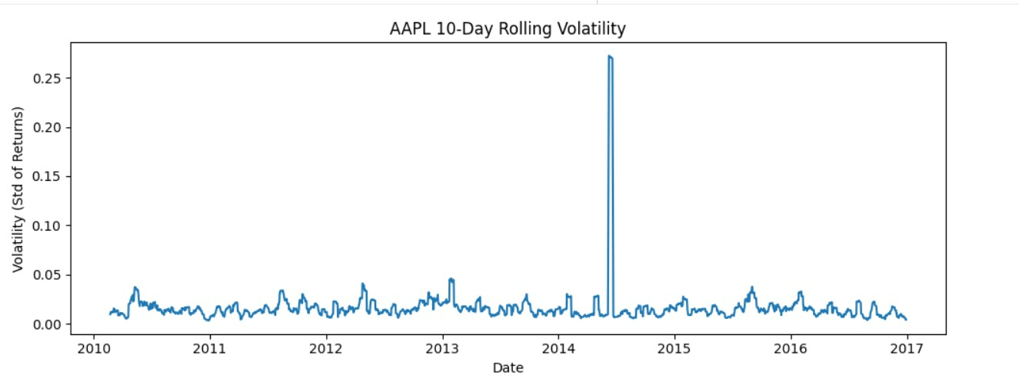

Slide 12
Backtesting Summary
Sharpe Ratio: 0.56
Max Drawdown: -0.317
Final Strategy Return: 1.146x
Buy & Hold Return: 1.249x
➡ Model underperforms simple buy-and-hold.

Slide 13
Future enhancements
Introduce LSTM/GRU-based deep learning for modeling sequence data.
Incorporate macroeconomic elements and sentiment analysis.
Models based on multiple tickers simultaneously.
Hyperparameter tuning (Grid Search / Optuna).
Feature Selection and Dimensionality Reduction

Slide 14
limitations
The accuracy is near random because of Efficient Market Hypothesis.
Single-stock modelling prevents generalisation.
Technical indicators only; no news/sentiment data.
No optimization of transaction costs / slippage.
No advanced risk-adjusted portfolio optimization.

Slide 15
conclusion
ML models give a slight improvement over simple baselines.
Random Forest and XGBoost perform modestly but not enough for profitable trading.
Backtesting shows model predictions do not outperform
Data quality affects outcomes to some extent.
It shows excellent pipeline for ML time series on finance projects.

Slide 16
Thank You

